Slide 1

“La U.E. y las posibilidades de pesca en 2019: Obligación de desembarque, proceso hacia el rendimiento máximo sostenible (RMS), la situación de los caladeros europeos de Gran-Sol y de las Aguas Ibéricas”
XXIII JORNADAS TÉCNICAS DE DIFUSIÓN DEL SECTOR PESQUERO
Celeiro, 23 y 24 de noviembre de 2018

Slide 2
OBLIGACIÓN DESEMBARQUE
ÁMBITO DE APLICACIÓN
Todas las especies reguladas por TAC y cuotas
Todos los buques europeos independientemente del arte de pesca
Hay excepciones para ciertas flotas:
  Justificadas científicamente
  Permitirán descartar volúmenes que se fijen en la normativa
  Algunas son temporales y su continuidad dependerá de que se aporte información científica adicional que la COM y el STECF evalúen suficiente

Slide 3
OBLIGACIÓN DESEMBARQUE
ÁMBITO DE APLICACIÓN
Las flotas que no dispongan de exenciones de ningún tipo deberán:
  traer todas las capturas realizadas
  desembarcarlas
  computarlas contra las cuotas
  y destinarlas al uso que esté permitido en cada caso

Slide 4
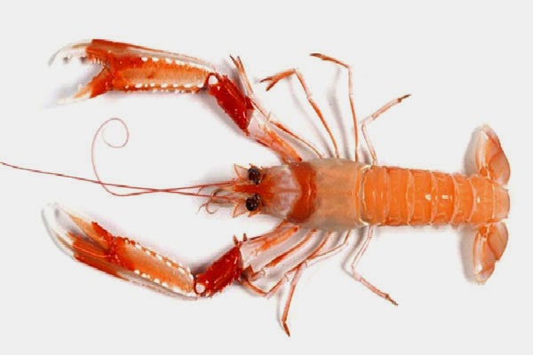
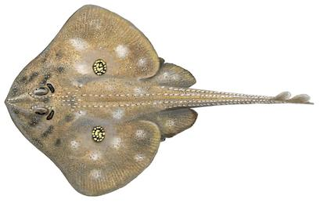
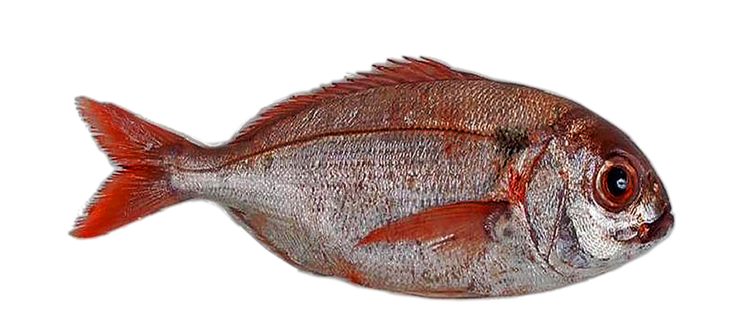
AGUAS SUROCCIDENTALES
DEMERSALES 2019
EXCEPCIÓN : ALTA SUPERVIVENCIA 2019-2021
Cigala en el arrastre zonas 8 y 9
Rayas todas las especies, todas las artes en zonas 8 y 9
  Nota: para la raya santiaguesa solo durante 2019
  A la espera de más información científica.
Besugo para voracera zona 9a
Notes:
Article 3 Survivability exemption for Norway lobster CIGALA
1. The exemption from the landing obligation for species for which scientific evidence demonstrates high survival rates, as provided for in Article 15(4)(b) of Regulation (EU) No 1380/2013, shall apply to Norway lobster (Nephrops norvegicus) caught in ICES subareas 8 and 9 with trawls (gear codes12: OTB, OTT, PTB, TBN, TBS, TB, TBB, OT, PT and TX).
2. When discarding Norway lobster caught in cases referred to in paragraph 1, the Norway lobster shall be released whole, immediately and in the area where it has been caught.
Article 4 Survivability exemption for skates and rays RAYAS
1. The exemption from the landing obligation for species for which scientific evidence demonstrates high survival rates, as provided for in Article 15(4)(b) of Regulation (EU) No 1380/2013, shall apply to skates and rays (Rajiformes) caught with all gears in ICES subareas 8 and 9. When discarding skates and rays caught in that area, they shall be released immediately.
2. Member States having a direct management interest shall submit yearly additional scientific information supporting the exemption laid down in paragraph 1. The
Scientific, Technical and Economic Committee for Fisheries shall assess the provided scientific information before 1 August every year.
3. The exemption referred to in paragraph 1 shall apply to Cuckoo ray until 31 December 2019. Member States having a direct management interest shall submit as soon as possible before 31 May 2019, additional scientific information supporting that exemption. The Scientific, Technical and Economic Committee for Fisheries shall assess the provided scientific information before 1 August 2019.
Article 5 Survivability exemption for red sea bream BESUGO O VORAZ EN EL ESTRECHO PESCADO CON VORACERA
1. The exemption from the landing obligation for species for which scientific evidence demonstrates high survival rates, as provided for in Article 15(4)(b) of Regulation (EU) No 1380/2013, shall apply to red seabream (Pagellus bogaraveo) caught with the artisanal gear voracera used in ICES division 9a and to red seabream (Pagellus bogaraveo) caught with hooks and lines in ICES subarea 10.
2. When discarding red sea bream caught in cases referred to in paragraph 1, the red seabream shall be released immediately.

Slide 5
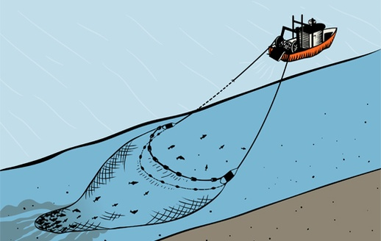
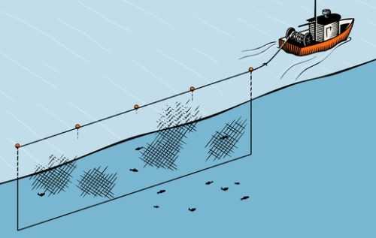
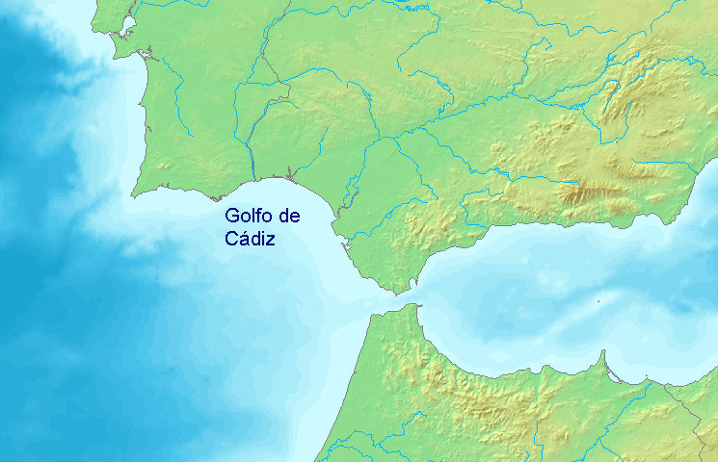
AGUAS SUROCCIDENTALES
DEMERSALES 2019
EXCEPCIONES De MINIMIS
Arrastre de fondo zonas 8 y 9: merluza, gallo, rape, solla europea, abadejo, merlan, jurel, caballa, anchoa y ochavo
Enmalle zonas 8 y 9: gallo, solla europea, abadejo, merlán, jurel y caballa.
Solo para Golfo de Cádiz: besugo y lenguado
Notes:
Article 6 De minimis exemptions
1. By way of derogation from Article 15(1) of Regulation (EU) No 1380/2013, the following quantities may be discarded pursuant to Article 15(5)(c) of that Regulation:
(a) for hake MERLUZA (Merluccius merluccius), up to a maximum of 6% in 2019 of the total annual catches of that species by vessels using trawls and seines (gear codes: OTT, OTB, PTB, OT, PT, TBN, TBS, TX, SSC, SPR, TB, SDN, SX, SV) and targeting that species in ICES subareas 8 and 9;
(b) for common sole (Solea solea), up to a maximum of 5% of the total annual catches of that species by vessels using beam trawl and bottom trawls (gear codes: OTB, OTT, PTB, TBN, TBS, TBB, OT, PT and TX) and targeting that species in ICES divisions 8a and 8b;
(c) for common sole LENGUADO (Solea solea), up to a maximum of 3% of the total annual catches of that species by vessels using trammel nets and gillnets (gear codes: GNS, GN, GND, GNC, GTN, GTR and GEN) and targeting that species in ICES divisions 8a and 8b;
(d) for alfonsinos ALFONSINOS(Beryx spp.), up to a maximum of 5%, of the total annual catches of that species by vessels using hooks and lines (gear codes: LHP, LHM, LLS, LLD) in ICES subarea 10;
(e) for great forkbeard BROTOLA (Phycis blennoides), up to a maximum of 3% of the total annual catches of that species by vessels using hooks and lines (gear codes: LHP, LHM, LLS, LLD) in ICES subarea 10;
(f) for horse mackerel JUREL (Trachurus spp.), up to a maximum of 7% in 2019 of the total annual catches of that species by vessels using beam trawl, bottom trawls and seines (gear codes: OTB, OTT, PTB, TBN, TBS, TBB, OT, PT, TX, SSC, SPR, SDN, SX, SV) in ICES subareas 8 and 9;
(g) for horse mackerel JUREL (Trachurus spp.), up to a maximum of 3% in 2019 of the total annual catches of that species by vessels using gillnets (gear codes: GNS, GND, GNC, GTR, GTN) in ICES subareas 8, 9 and 10 and and CECAF areas 34.1.1, 34.1.2, 34.2.0;
(h) for mackerel CABALLA (Scomber scombrus), up to a maximum of 7% in 2019 of the total annual catches of that species by vessels using beam trawl, bottom trawls and seines (gear codes: OTB, OTT, PTB, TBN, TBS, TBB, OT, PT, TX, SSC, SPR, SDN, SX, SV) in ICES subareas 8 and 9;
(i) for mackerel CABALLA (Scomber scombrus), up to a maximum of 3% in 2019 of the total annual catches of that species by vessels using gillnets (gear codes: GNS, GND, GNC, GTR, GTN) in ICES subareas 8, 9 and 10 and and CECAF areas 34.1.1, 34.1.2, 34.2.0;
(j) for anchovy (Engraulis encrasicolus), up to a maximum of 7% in 2019 of the total annual catches of that species by vessels using beam trawl, bottom trawls and seines (gear codes: OTB, OTT, PTB, TBN, TBS, TBB, OT, PT, TX, SSC, SPR, SDN, SX, SV) in ICES subareas 8 and 9;
(k) for boarfish OCHAVO (Caproidae), up to a maximum of 7% in 2019 of the total annual catches of that species by vessels using beam trawl, bottom trawls and seines (gear codes: OTB, OTT, PTB, TBN, TBS, TBB, OT, PT, TX, SSC, SPR, SDN, SX, SV) in ICES subareas 8 and 9;
(l) for megrim GALLO (Lepidorhombus spp.), up to a maximum of 5% in 2019 of the total annual catches of that species by vessels using beam trawl, bottom trawls and seines (gear codes: OTB, OTT, PTB, TBN, TBS, TBB, OT, PT, TX, SSC, SPR, SDN, SX, SV) in ICES subareas 8 and 9;
(m) for megrim GALLO (Lepidorhombus spp.), up to a maximum of 4% in 2019 of the total annual catches of that species by vessels using gillnets (gear codes: GNS, GND, GNC, GTR, GTN) in ICES subareas 8 and 9;
(n) for plaice SOLLA (Pleuronectes platessa), up to a maximum of 5% in 2019 of the total annual catches of that species by vessels using beam trawl, bottom trawls and seines (gear codes: OTB, OTT, PTB, TBN, TBS, TBB, OT, PT, TX, SSC, SPR, SDN, SX, SV) in ICES subareas 8 and 9;
(o) for plaice SOLLA (Pleuronectes platessa), up to a maximum of 4% in 2019 of the total annual catches of that species by vessels using gillnets (gear codes: GNS, GND, GNC, GTR, GTN) in ICES subareas 8 and 9;
(p) for anglerfish RAPE (Lophiidae), up to a maximum of 5% in 2019 of the total annual catches of that species by vessels using beam trawl, bottom trawls and seines (gear codes: OTB, OTT, PTB, TBN, TBS, TBB, OT, PT, TX, SSC, SPR, SDN, SX, SV) in ICES subareas 8 and 9;
(q) for anglerfish RAPE (Lophiidae), up to a maximum of 4% in 2019 of the total annual catches of that species by vessels using gillnets (gear codes: GNS, GND, GNC, GTR, GTN) in ICES subareas 8 and 9;
(r) for whiting MERLAN (Merlangius merlangus), up to a maximum of 5% in 2019 of the total annual catches of that species by vessels using beam trawl, bottom trawls and seines (gear codes: OTB, OTT, PTB, TBN, TBS, TBB, OT, PT, TX, SSC, SPR, SDN, SX, SV) in ICES subareas 8 and 9;
(s) for whiting MERLAN (Merlangius merlangus), up to a maximum of 4% in 2019 of the total annual catches of that species by vessels using gillnets (gear codes: GNS, GND, GNC, GTR, GTN) in ICES subareas 8 and 9;
(t) for pollack ABADEJO (Pollachius pollachius), up to a maximum of 5% in 2019 of the total annual catches of that species by vessels using beam trawl, bottom trawls and seines (gear codes: OTB, OTT, PTB, TBN, TBS, TBB, OT, PT, TX, SSC, SPR, SDN, SX, SV) in ICES subareas 8 and 9;
(u) for pollack ABADEJO (Pollachius pollachius), up to a maximum of 4% in 2019 of the total annual catches of that species by vessels using gillnets (gear codes: GNS, GND, GNC, GTR, GTN) in ICES subareas 8 and 9;
(v) for great forkbeard BROTOLA DE FONDO (Phycis blennoides), up to a maximum of 7% in 2019 of the total annual catches of that species by vessels using beam trawl, bottom trawls and seines (gear codes: OTB, OTT, PTB, TB, TBN, TBS, OT, PT, TX, SSC, SPR, SDN, SX, SV) in ICES division 9a; OJO SE QUITA DEL TAC
(x) for red seabream BESUGO (Pagellus bogaraveo), up to a maximum of 7% in 2019 of the total annual catches of that species by vessels using beam trawl, bottom trawls and seines (gear codes: OTB, OTT, PTB, TB, TBN, TBS, OT, PT, TX, SSC, SPR, SDN, SX, SV) in ICES division 9a;
(y) for sole LENGUADO (Solea spp.), up to a maximum of 7% in 2019 of the total annual catches of that species by vessels using beam trawl, bottom trawls and seines (gear codes: OTB, OTT, PTB, TB, TBN, TBS, OT, PT, TX, SSC, SPR, SDN, SX, SV) in ICES division 9a.
2. The de minimis exemptions set out in the paragraph 1 points (a) and (f)-(y) shall be provisionally applicable until 31 December 2019. Member States having a direct management interest shall submit as soon as possible before 31 May 2019, additional scientific information supporting the exemption. The Scientific, Technical and Economic Committee for Fisheries shall assess the provided scientific information before 1 August 2019.

Slide 6
AGUAS NOROCCIDENTALES
DEMERSALES 2019
EXCEPCIONES ALTA SUPERVIVENCIA 2019 - 2021
Rayas todas las especies, todas las artes en zonas 6 y 7
  Nota: para la raya santiaguesa solo durante 2019
  A la espera de más información científica.
Cigala en el arrastre en zonas 6 y 7, con ciertas restricciones de artes de pesca y medidas técnicas
Notes:
Article 3 Survivability exemption for Norway lobster
1. The survivability exemption provided for in Article 15(4)(b) of Regulation (EU) No 1380/2013 shall apply to:
(a) Norway lobster (Nephrops norvegicus) caught in pots, traps or creels (gear codes:16 FPO and FIX), in ICES subareas 6 and 7;
(b) Norway lobster (Nephrops norvegicus) caught with bottom trawls with a mesh size equal to or larger than 100 mm in ICES subarea 7;
(c) Norway lobster (Nephrops norvegicus) caught with bottom trawls with a mesh size of 70-99 mm in combination with highly selective gear options in ICES subarea 7;
(d) Norway lobster (Nephrops norvegicus) caught with otter trawls with a mesh size of 80-110 mm in combination with highly selective gear options in ICES division 6a within twelve nautical miles of the coast.
2. When discarding Norway lobster caught in cases referred to in paragraph 1, the Norway lobster shall be released whole, immediately and in the area where it has been caught.
Survivability exemption for skates and rays
1. The survivability exemption provided for in Article 15(4)(b) of Regulation (EU) No 1380/2013 shall apply to total allowable catches of skates and rays (Rajiformes) caught by any fishing gear in the North Western Waters (ICES subareas 5 (excluding 5a and including only Union waters of 5b), 6 and 7).
2. Member States having a direct management interest shall submit, every year as soon as possible before 31 May, additional scientific information supporting the exemption laid down in paragraph 1. The Scientific, Technical and Economic Committee for Fisheries (STECF) shall assess the provided scientific information before 1 August every year.
3. The exemption set out in paragraph 1 shall apply to Cuckoo ray until 31 December 2019. Member States having a direct management interest shall submit as soon as possible before 31 May 2019, additional scientific information supporting that exemption. The Scientific, Technical and Economic Committee for Fisheries (STECF) shall assess the provided scientific information before 1 August 2019.
4. When discarding skates and rays caught in cases referred to in paragraph 1, the skates and rays shall be released immediately and below the sea surface.

Slide 7
AGUAS NOROCCIDENTALES
DEMERSALES 2019
EXCEPCIONES DE MINIMIS
Arrastre de fondo zonas 6 y 7:
merlán, eglefino, jurel y caballa
Notes:
Article 8 De minimis exemptions
1. By way of derogation from Article 15(1) of Regulation (EU) No 1380/2013, the following quantities may be discarded pursuant to Article 15(5)(c) of that Regulation:
(b) for whiting (Merlangius merlangus), up to a maximum of 6% in 2019, and up to a 5% in 2020 and 2021, of the total annual catches of that species by vessels using bottom trawls and seines with a mesh size equal to or greater than 80 mm (OTB, OTT, OT, PTB, PT, SSC, SDN, SPR, SX, SV, TBN, TBS, TB, TX), pelagic trawls (OTM, PTM) and beam trawls (BT2) with a mesh size of 80-119 mm in ICES divisions 7b-c and 7e-k;
(e) for haddock (Melanogrammus aeglefinus), up to a maximum of 7% in 2019 of the total annual catches of that species by vessels using bottom trawls, seines and beam trawls with a mesh size equal to or greater than 80 mm in ICES divisions 7b-7c and 7e-7k;
(g) for horse mackerel (Trachurus spp.), up to a maximum of 7% in 2019 of the total annual catches of that species by vessels using bottom trawls, seines and beam trawls in ICES subarea 6 and ICES divisions 7b-7k;
(h) for mackerel (Scomber scombrus), up to a maximum of 7% in 2019 of the total annual catches of that species by vessels using bottom trawls, seines and beam trawls in ICES subarea 6 and ICES divisions 7b-7k.
2. The de minimis exemptions set out in the paragraph 1 points (e)-(h) shall be applicable until 31 December 2019. Member States having a direct management interest shall submit as soon as possible before 31 May 2019, additional scientific information supporting the exemption. The Scientific, Technical and Economic Committee for Fisheries shall assess the provided scientific information before 1 August 2019.

Slide 8

OTRAS SOLUCIONES PARA EVITAR PROBLEMA ESTRANGULAMIENTO
Condiciones especiales entre distintas áreas
Uso de la flexibilidad interespecies
Eliminación de la gestión por TAC y cuotas de ciertas poblaciones de peces que en su mayoría son capturas accesorias no deseadas
Cuotas para cubrir capturas accesorias para flotas que tiene cuota cero
Intercambios de cuota entre EEMM para dar solución a ciertas carencias
Nota: La obtención de algunas de las flexibilidades podría estar supeditada a la implementación de medidas más selectivas para las flotas que lo necesiten.
Notes:
Meter ejemplos de condiciones especiales
Eliminación de TACs por ejemplo ya se ve en el reglamento de profundas en el que se ha quitado la brótola de fondo, se ha pedido también para ochavo y pejerrey.
Bolsa de cuota, propuesta que no está siendo muy bien recibida por ciertos EEMM
Swaps, vamos a tener reuniones con los EEMM para estos temas.

Slide 9
ESPECIES SIN PROBLEMA EN 2019

Slide 10
ESPECIES EN LAS QUE PERSISTE UN PROBLEMA DE ESTRANGULAMIENTO

Slide 11
ESPECIES POR DETERMINAR SI SON O NO SON UN PROBLEMA

Slide 12
EL OBJETIVO DEL RENDIMIENTO MÁXIMO SOSTENIBLE
La PCP obliga a conjugar:
  la búsqueda de la sostenibilidad del recurso,
  pero también el mantenimiento de objetivos económicos, sociales y de empleo
El RMS → alcanzar como muy tarde en 2020.
  La Comisión → Alcanzar el mayor número de stocks ya en 2019
Para ello, se basa en la información científica de ICES

Slide 13
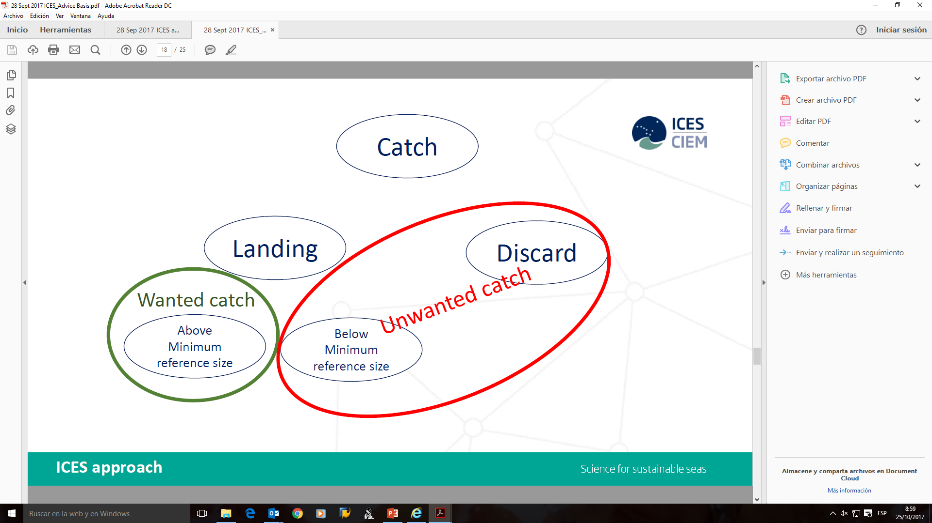
EL OBJETIVO DEL RENDIMIENTO MÁXIMO SOSTENIBLE
CON TODA LA INFORMACIÓN, SE LLEGA A CONCER LO QUE SE PUEDE PESCAR Y LO QUE NO SE DEBE PESCAR

Slide 14
RMS EN 2019
Actualmente, hay 53 especies cuyos límites de captura se sitúan a nivel del RMS, 9 más que en 2017, lo que supone dos tercios de lo pescado en el Atlántico Norte (a nivel comunitario)
Como dato de partida, en 2009, solo 5 stocks se situaban a este nivel.
Futuro: avanzar para alcanzar el máximo rendimiento a todos los niveles: Equilibrar la balanza entre RMS de los stocks y rendimiento económico del sector.

Slide 16
TAC Y CUOTAS 2019
ESPECIES QUE SUBE EL TAC

Slide 17
TAC Y CUOTAS 2019
ESPECIES ESTABLES

Slide 18
TAC Y CUOTAS 2019
ESPECIES QUE BAJAN

Slide 19
CALADERO NACIONAL CNW Y GRAN SOL
RETOS 2019
La mayoría de los recursos en RMS. Tan solo la merluza sigue por debajo y la cigala que sigue muy mal.
Peores perspectivas para 2019: Merluza Sur (-14%) y Caballa (-25%)
Subida de jurel importante (69% y 18%)
Sigue habiendo un exceso de capacidad con respecto a las cuotas máximas disponibles, aunque la flota está siendo rentable en muchas de las modalidades
Necesidad de mecanismos de flexibilidad para uso eficiente de la cuota nacional disposible

Slide 20
Muchas gracias
ISABEL ARTIME GARCIA
DIRECTORA GENERAL DE RECURSOS PESQUEROS

Slide 21
FLOTA CALADERO GRAN SOL
Mayoría de los stocks en buen estado (preocupación por la caída de rendimientos de merluza)
Flota operativa 89 buques (29 arrastre-60 palangre (4 de menos de 100trb))
Ajuste de la capacidad a los recursos

Slide 22
FLOTA CENSO CNW

